Slide 1
Buyers Retention and Acquisition Strategy using AI
Sonova Audiological Care
Presented By Ashish Gupta

Slide 2
Agenda for Today
Business Objective
Dataset
Key Strategic Insights
Key Strategic Recommendation

Slide 3


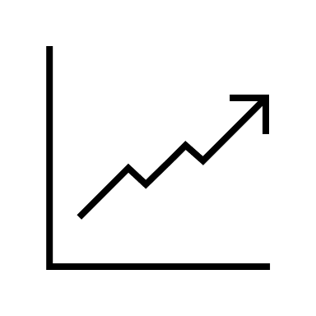
Business Objective
Be a Market Leader!, improve Customer retention and acquisition for hearing aid products across Canada.
Understand Key Performance Indicators that supports the business strategical objective.
Build a Data driven solution to drive customized promotional campaign.
Notes:
Sonova’s Audiological Care (AC) is one of the largest business units comprising of a network of stores through which consumers can purchase hearing aids and other accessories directly. One of the key objectives in AC is to continuously increase the number of customers who repurchase a hearing aid from one of our stores.
In an effort to improve the repurchase rate, the VP of Marketing has asked me to use historical data to better understand the key drivers of repurchase and build a data science model that enables the marketing department to better tailor their promotional campaigns

Slide 4




Dataset
Audiograms : Hearing loss level – Combined, left and right ear.
Calls : Date Created, Call Type, Call List.
Contacts : Gender, Postal Code, Deceased, Year of Birth.
Sales : Sales Date, Product Type, Discount Code.

Slide 5




Key Strategic Insights
19.5%
Sales have significantly dropped in FY2020.
7%
Call Volume have dropped in FY2020.
38%
Maximum Customers by Province : British Columbia.
412
Maximum Customers by City : Meadowvale, Nova Scotia.
1.5%
Customers suffer from total hear loss.
Notes:
Further decline is anticipated by FY 2021. Sales year was also very significant for our solution, which will be explained further
After analyzing the sales data, i can track the customers who have repurchased the hearing aid in the past. These customers are mostly likely to buy from Sonova Stores again. Also, there is another set of customers, who have a valid discount code, they are also one of the contenders for repurchase of hearing aids. Considering this as a classification problem, I want to identify which customers are likely to repurchase, and i will also identify the significant drivers to identify the factors behind the repurchase.

Slide 6
References : Data Visualizations

Slide 7
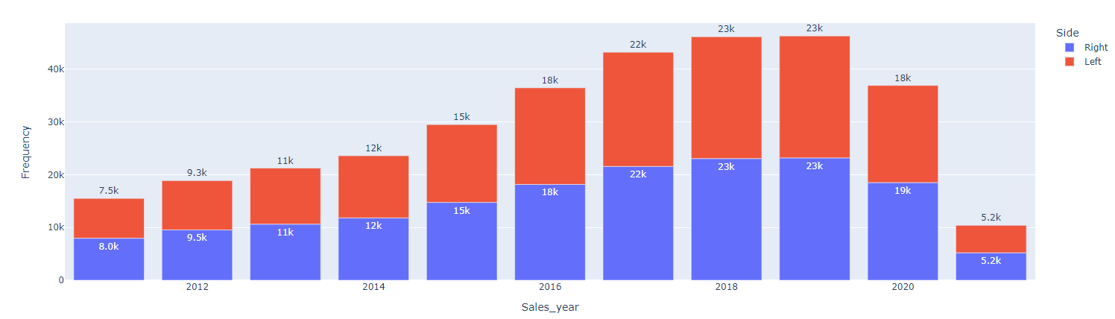
Reference 1 : Last 10 years Sales Data

Slide 8
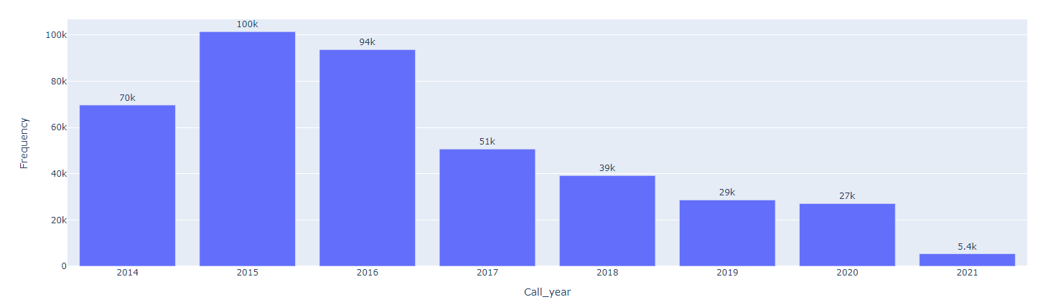
Reference 2 : Last 10 years Call Volume Data

Slide 9
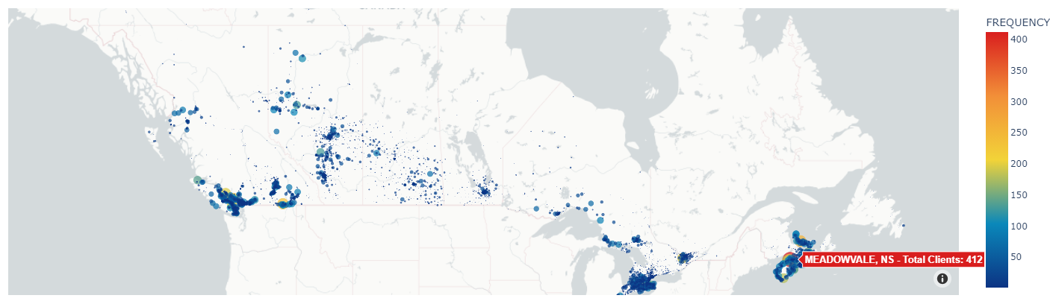
Reference 3 : Customer Base across Canada

Slide 10
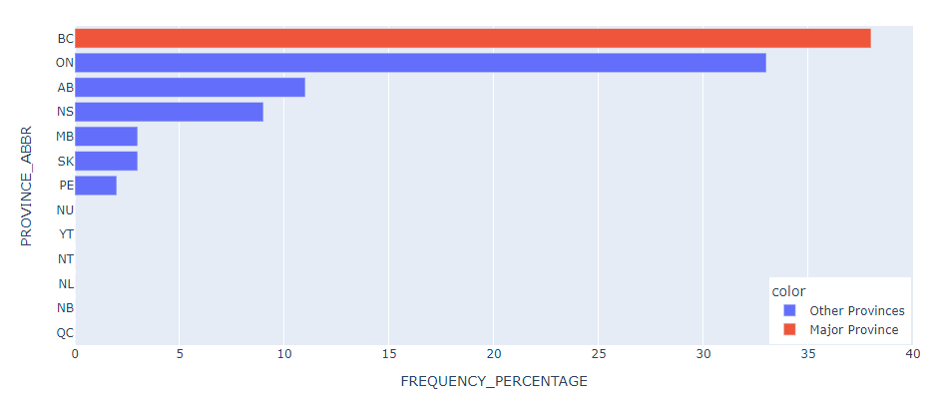
Reference 4 : Customer Base across Canada – By Province

Slide 11
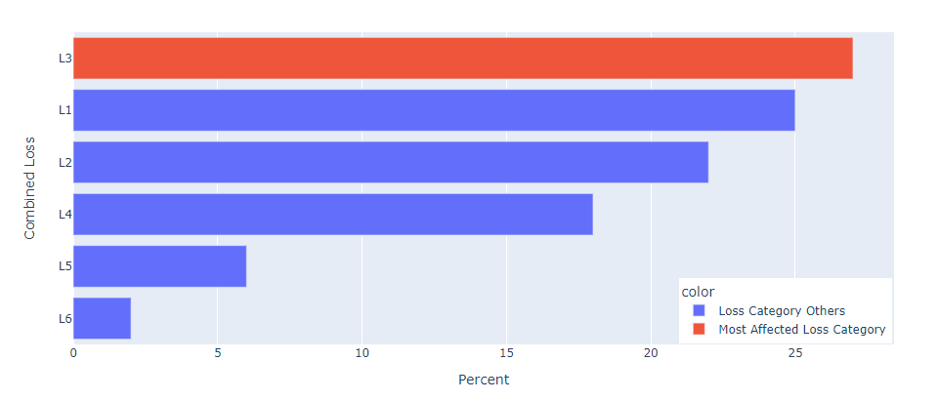
Reference 5 : Customer Affected by Combined Loss

Slide 12
References : ML Model Interpretations

Slide 13


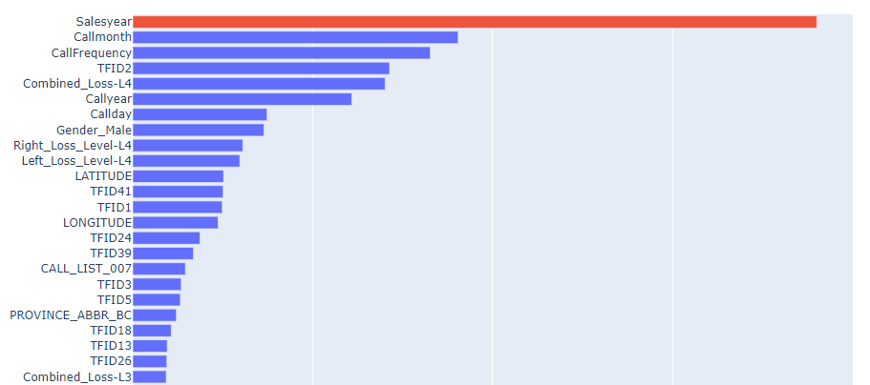
Random Forest Classifier
64%
Recall
76%
ROC-AUC
Top Features
Notes:
Accuracy is ROC AUC Metrics

Slide 14
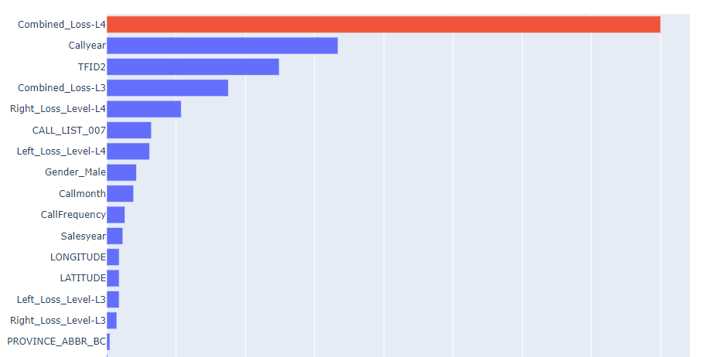
Extra Trees Classifier
48%
Recall
68%
ROC AUC
Top Features

Slide 15
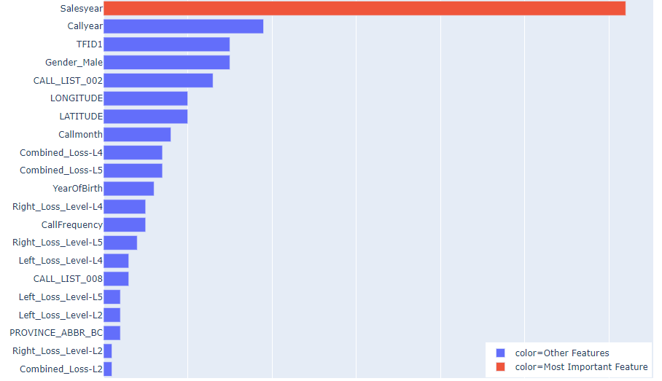
ADA Boost Classifier
69%
Recall
80%
ROC AUC
Top Features

Slide 16
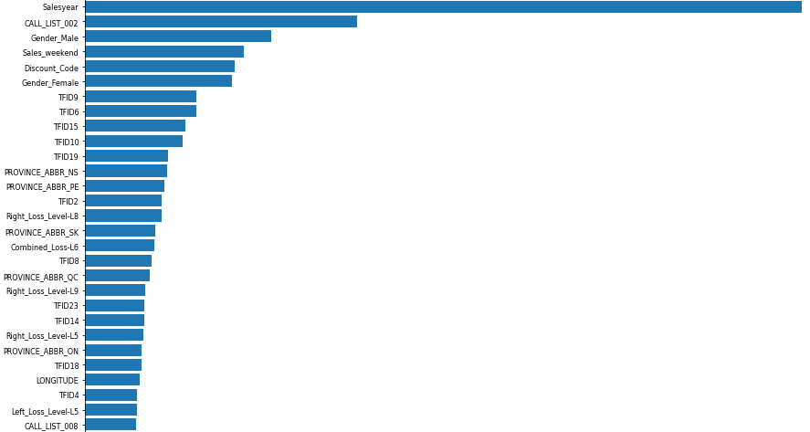
Logistic Regression
71%
Recall
81%
ROC AUC

Slide 17
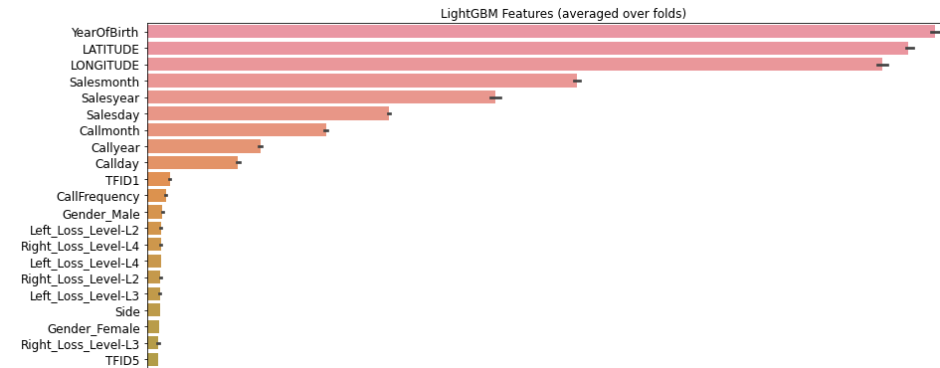
LIGHT GBM Classifier (In Production)
89%
Recall
97%
ROC-AUC

Slide 18



Key Strategic Recommendation
Capture New Market in New Brunswick, Quebec, Newfoundland and Labrador, and Canadian Territories.
Customized Promotional offers based on different age groups and Statutory Holidays.
Regular Discount Code will boost the repurchase.
Chatbot Assisted Services for Customers with advanced levels of complete loss.
Notes:
Capturing new markets, will also improve increasing call volumes from customer service.
Know your customer : Year of birth was significant in my models. So a recommended strategy is to Customize promotion for different ages. Also Call month was significant, so certain promotions can be applied on boxing day, Black friday
I found discount codes to be useful in my best model.
Advanced Complete Loss Levels L3, L4, L5 were important features extracted from models. A Chatbot will be useful, when assisting the customers using Call list.

